Slide 1
Team Binary-Fish tank monitoring system
Shanaaz Ahamed
Mohamed Sarraj

Slide 2
Feeding system
-components used
Servomotor SG90
Ultrasonic sensor
Feed the system only when feed available at feed bottle and operates at specified time only
Can change the specified times
Send(push) notification to android device when low feed (20% or less)
Can control the amount of feed supplied to fish
Update the available feed at the android app(it works only when internet available)

Slide 3
PH monitoring
Components
Arduino UNO
PH probe with BNC connector
Takes PH readings (take 5 readings and calculate the average for accuracy)
Sends to raspberry pi (Serial Communication between RPI and Arduino)
RPi sends to android app and display the PH value and status (it works only when internet available
Send(push) notification to android device when PH value out of range(good PH is between 6.5 and 8)

Slide 4
Turbidity Monitoring
Components
5MP Pi camera module
Takes photo of the word placed inside the water and detect the text in the photo using OCR
Not turbid if detected and need to change the water if not detected
Must adjust the threshold value for detection before starting the system due to the lighting conditions differ from place to place
We can make any turbid level as threshold turbid level by adjusting the threshold value in the code
Texts not detected after adding some turbid water(darkness cause more blackish portion in image)

Slide 5
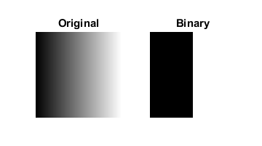
threshold
Binary thresh allows to get black and white image from grayscale image
0 means black and 255 white
Suppose we select a gray color 120 as threshold the colors having value more than 120 means lighter than 120 convert into white and below 120 means darken than 120 convert into black as seen in the image

Slide 6




Grayscale image
After setting threshold near white(255) means more portion of black in image
After setting threshold near black(0) means more portion of white in image

Slide 7



Both at threshold value 145

Slide 8


Before noise removal
After noise removal

Slide 9
Android APp
Displays the PH value and status, Turbidity status, Available feed

